Slide 1
JOBIFY

Slide 2





The Team :
Mohamed Anas Ayari
Yassine Ghzala
Taissir Bouzidi
Mohamed Taleb Mouelhi
Mohamed Amine Jabou
2

Slide 3

PLAN
Context
Used Technologies
Product Backlog
Sprint 1
Sprint 2
Sprint 3
Deployment
Conclusion & Retrospective
3

Slide 4

Jobify.
Context

Slide 5




Context: Problem
Inefficient and Time-Consuming recruitment Process
Challenges for recruiters
Issues for job seekers
5

Slide 6



Context : Similar application
LinkedIn
Indeed
SmartRecruiters
6

Slide 7

Solution:
Jobify
7

Slide 8
Jobify.
Work Flow

Slide 9





Candidate
9

Slide 10



Recruiter
10

Slide 11
Jobify.
Technologies Used

Slide 12






Frontend
Backend
Database Management
12

Slide 13
Jobify.
Product Backlog
Notes:
Since we used Scrum as our framework for the agile methodology , it was necessary to make an initial product backlog that will eventually change in each iteration
starting with sprint one

Slide 14

User story 1:
As a candidate, I want the system to automatically match my skills with job descriptions so that I can find relevant offers easily.
14
Notes:
As a candidate, I want the system to automatically match my skills with job descriptions so that I can find relevant offers easily.
This automation saves time, increases job relevance, and enhances the candidate experience.
As a recruiter, I want to receive recommendations for candidates with transferable skills so that I can consider a broader pool of candidates.
This widens the talent pool, enables smarter hiring, and supports roles requiring adaptable skills.

Slide 15


15
Notes:
US 6 :
As a recruiter, I want to manage job postings by adding, deleting, and modifying specific requirements for each position so that the AI engine can use these criteria to improve candidate matching and refine the selection process.
US 9 :
As a candidate, I want to view a list of job matches ranked by relevance so that I can prioritize my applications.
US8:
As a candidate, I want to receive feedback on my resume status so that I can understand my progress in the recruitment process.
US4:
As a recruiter, I want to receive notifications when candidates matching my job requirements apply so that I can review them promptly.

Slide 16

16
Notes:
Moving to sprint 3
For recruiters:
As a recruiter, I want to modify job offers after posting so that I can make necessary updates.'
As a recruiter, I want to view previously posted jobs so that
I can track candidate responses.'
Finally, recruiters often deal with expired job postings:
As a recruiter, I want to automatically refresh expired job postings so that the offers remain visible.
From the candidate's perspective:
As a candidate, I want the system to suggest skill-building resources when I fall short of job requirements so that I can improve my profile.

Slide 17
Jobify.
Sprint 1

Slide 18
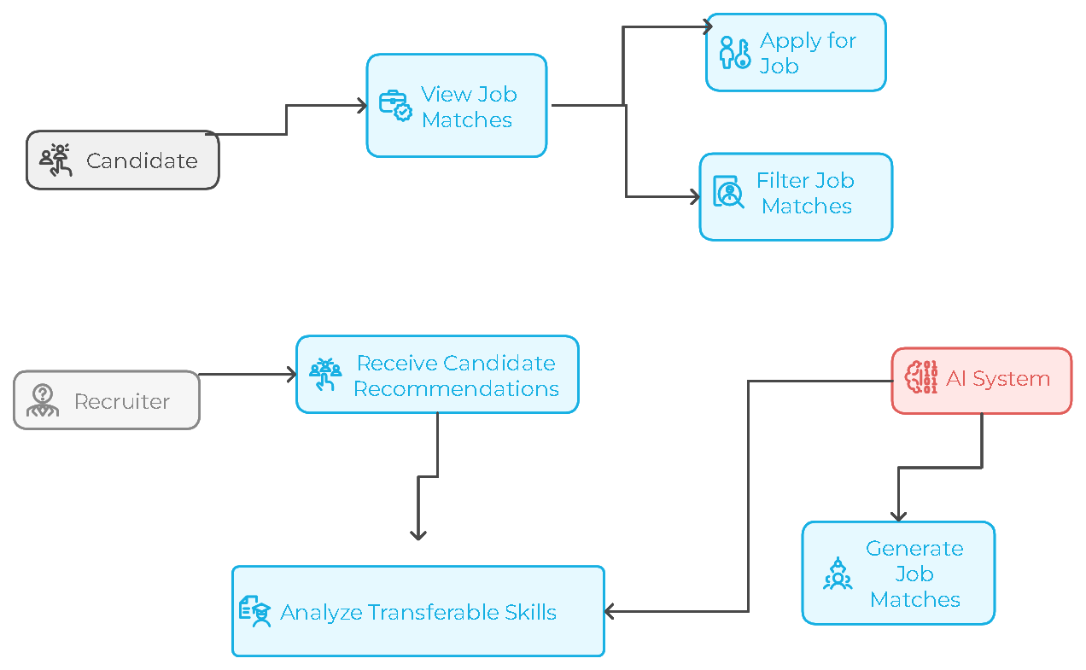
Sprint 1
Use Case Diagram
18

Slide 19
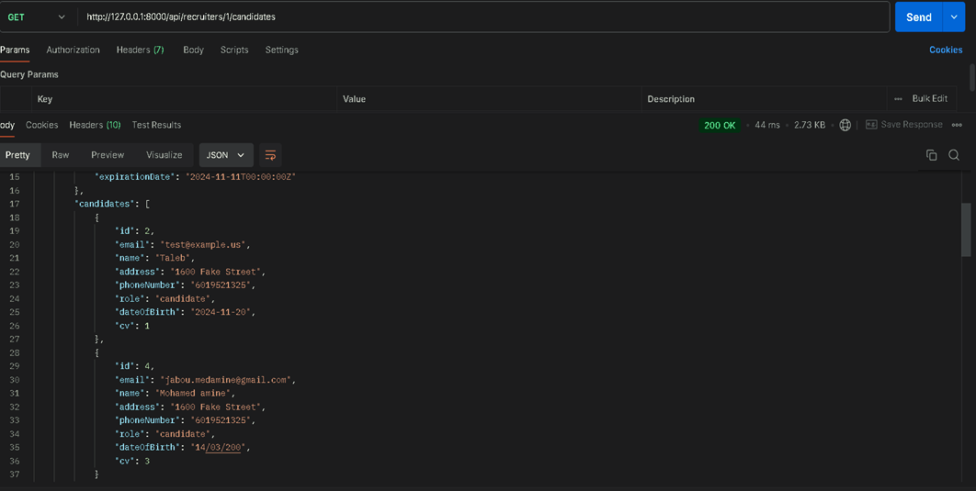
Sprint 1
Postman Test of User story 3
19

Slide 20
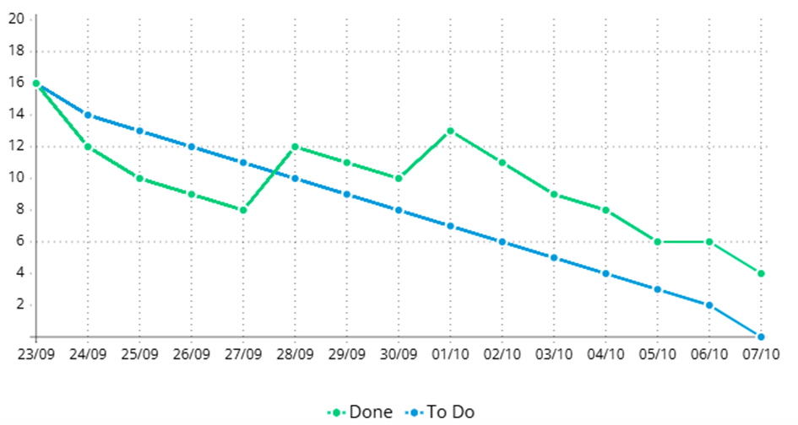
Burn Down Chart
Real
Ideal
20

Slide 21
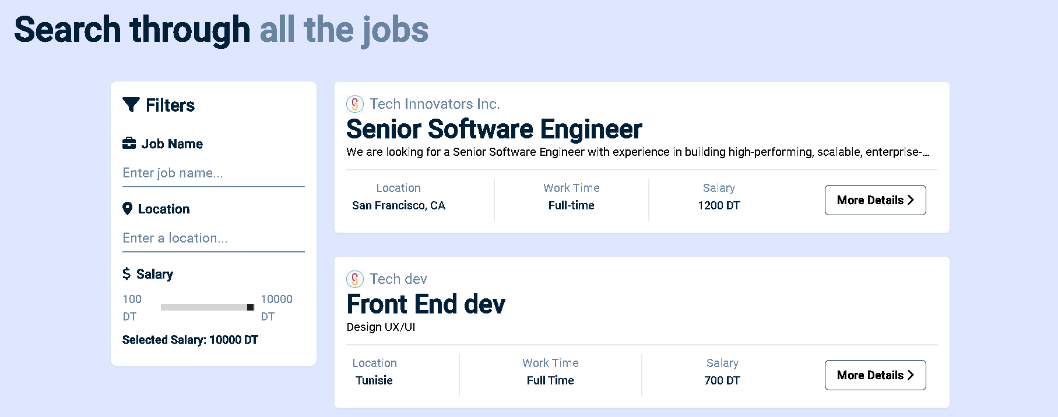
Interfaces
Use story 1
21

Slide 22
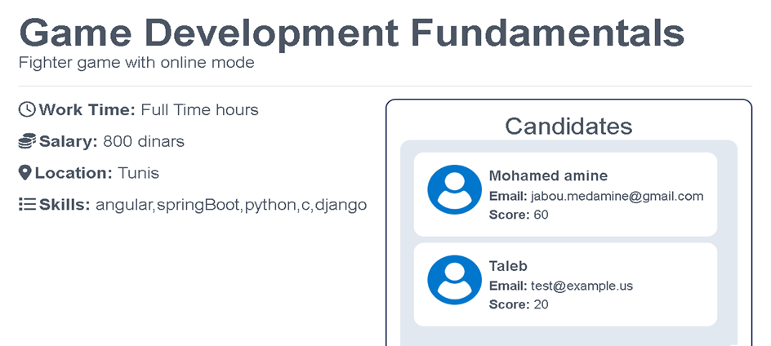
Interfaces
User story 3
22

Slide 23
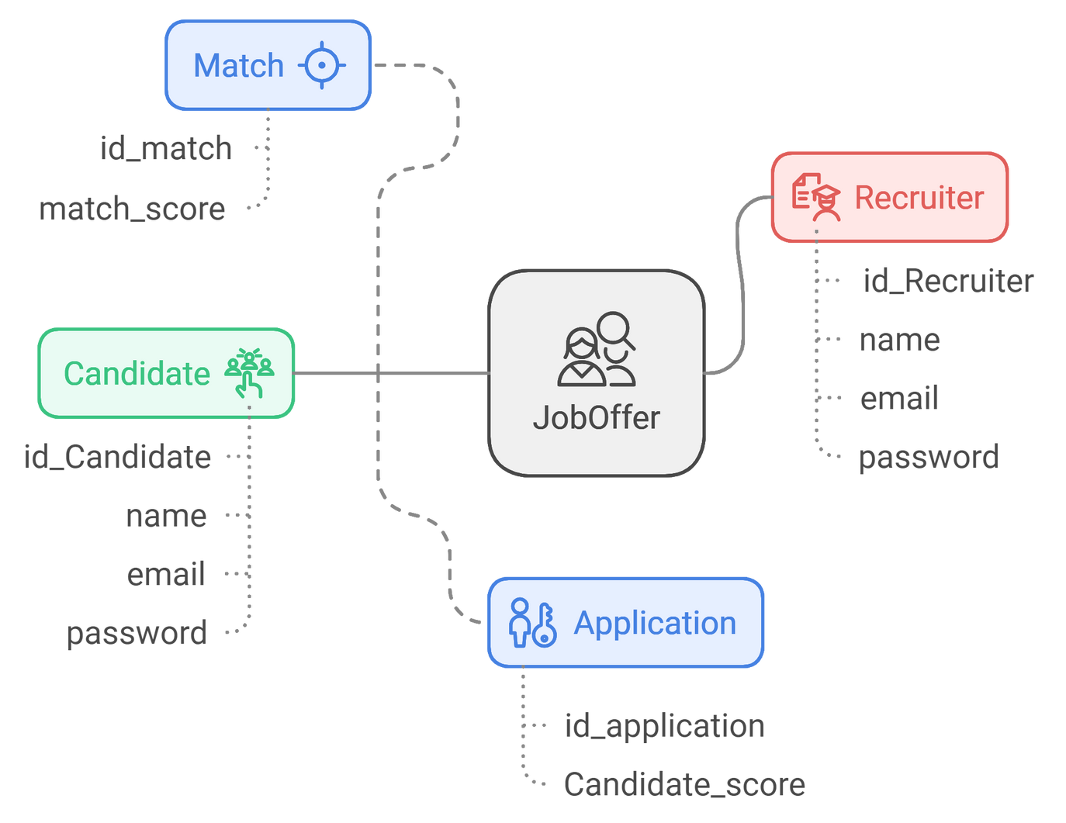
Sprint 1
Class Diagram
23

Slide 24
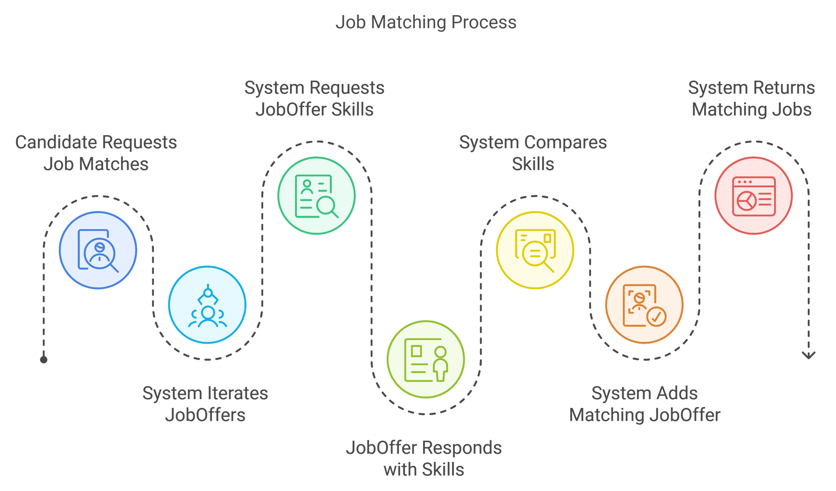
Sprint 1
Sequence Diagram
24

Slide 25


Retrospective Table
Went Good | To Improve | Action Plan
-Communication | -Effort Estimation -Stress Management -Time Management -Better Problem Handling -Resolve Punctuality issues | -Set Channels for Daily Scrum -Set Deadline for meets -Do better research before assigning point estimation
25

Slide 26

User Story | Sprint | Velocity
User story 6 User story 9 User story 8 User story 4 User story 11 | Sprint 2 | 25
User story 2 User story 7 User story 10 User story 5 User story 12 | Sprint 3 | 22
Updated Product Backlog
26

Slide 27
Jobify.
Sprint 2

Slide 28
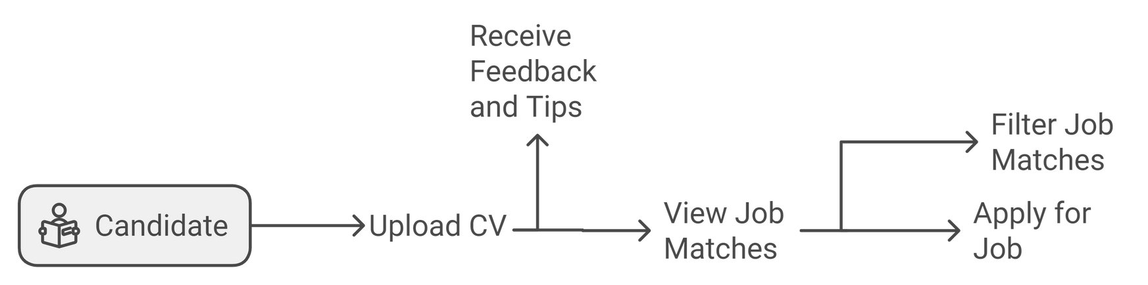
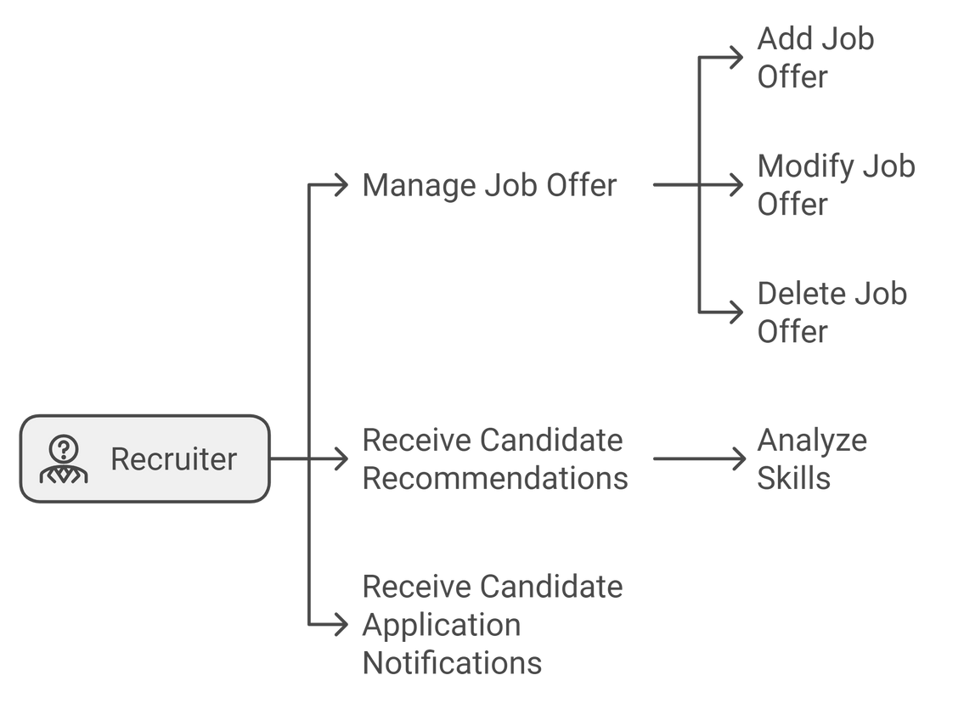
Sprint 2
Use Case Diagram
28

Slide 29
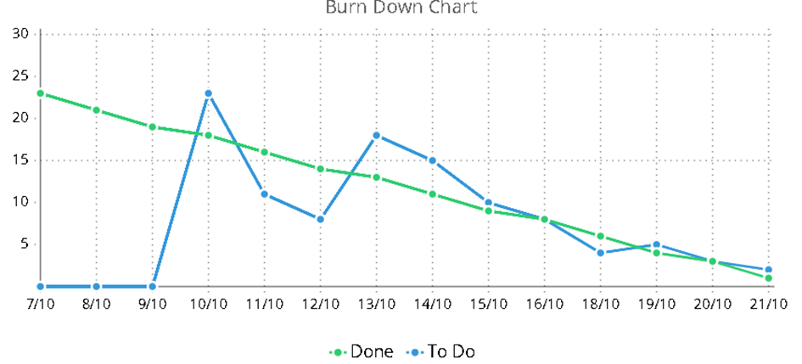
Burn Down Chart
Ideal
Real
29

Slide 30
Jobify.
Sprint 3

Slide 31
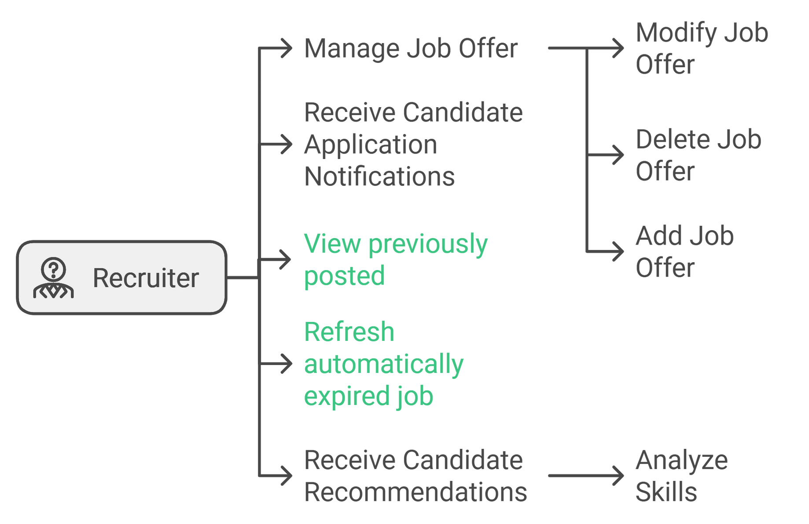
Sprint 3
Sprint 3
Use Case Diagram
Use Case
31
Notes:
in sprint 3 , we modified the use case diagram , adding the possibility for the recruiter to view his previously posted jobs and the option to refresh the expired jobs to make sure they still can be visible

Slide 32
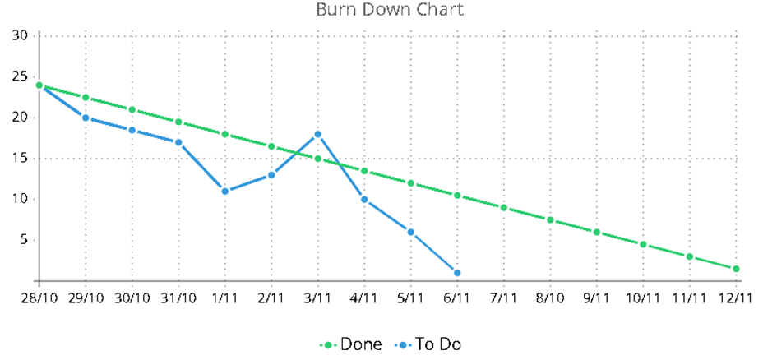
Burn Down Chart
Ideal
Real
32
Notes:
From the chart, we can observe:
Early progress was steady, aligning closely with the ideal line.
Around the 4th and 5th of November, there was a spike, indicating additional work or slower task completion.
After that, the team picked up the pace, and by the end of the timeline, we are almost aligned with the ideal goal.

Slide 33
Jobify.
Documentation
Using Swagger
Notes:
Accurate documentation is essential for any project as it helps developers and stakeholders understand how to use the system effectively. It ensures clarity, reduces miscommunication, and makes collaboration more seamless.

Slide 34

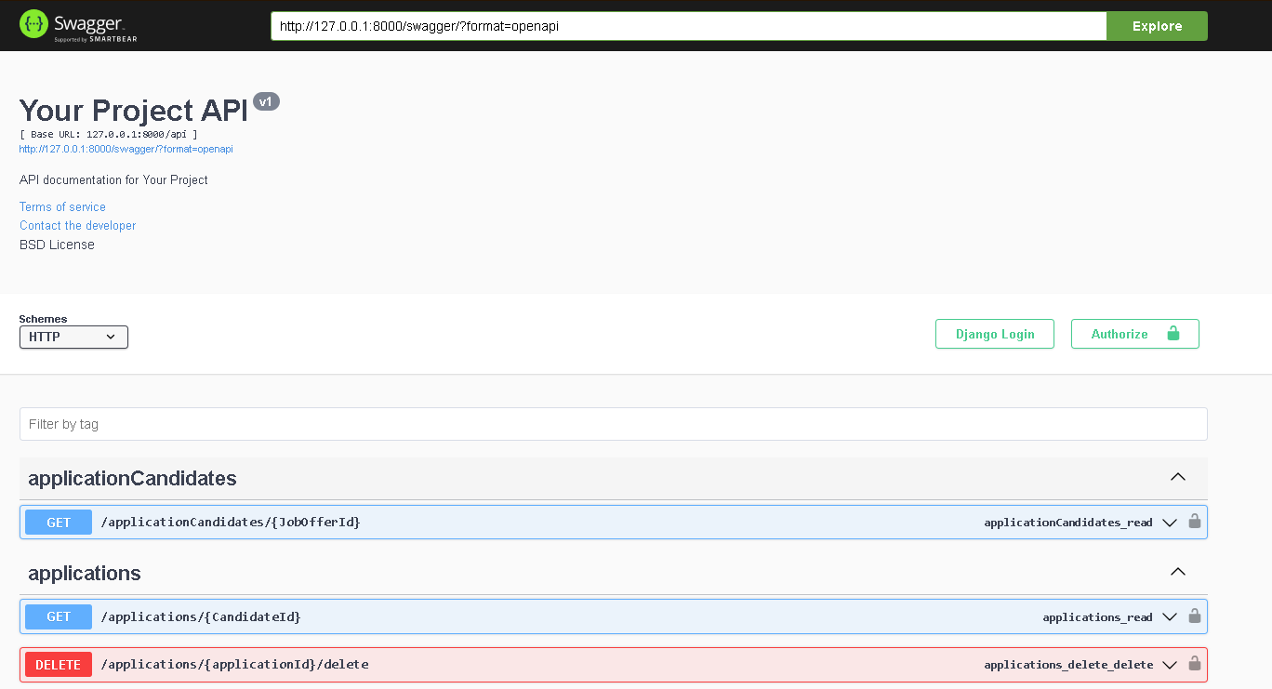
34
Notes:
Swagger is an open-source tool used for documenting REST APIs. It provides a user-friendly interface where all endpoints, their methods, and the required data are displayed clearly, making it easier for developers to test and interact with the API.

Slide 35
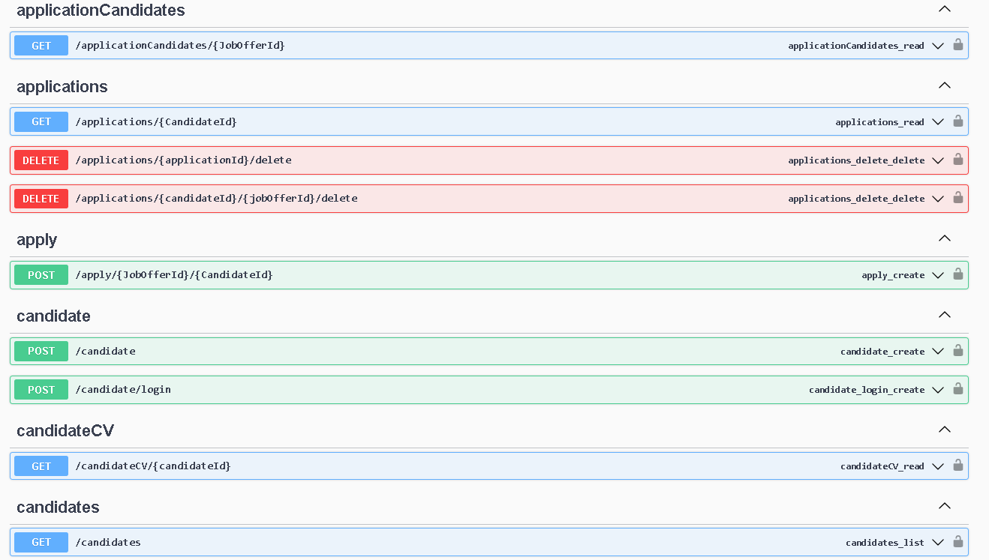
35
Notes:
We integrated Swagger in our Django backend using the drf-spectacular package. This tool automatically generates documentation for our endpoints by analyzing the API views and serializers defined in our project."
Benefits of Using Swagger:
"With Swagger, our API documentation is always up-to-date with the codebase. It allows developers to visualize all available endpoints, their functionality, and the expected inputs and outputs without additional effort."

Slide 36
Jobify.
Deployment

Slide 37



Used Technologies
37

Slide 38
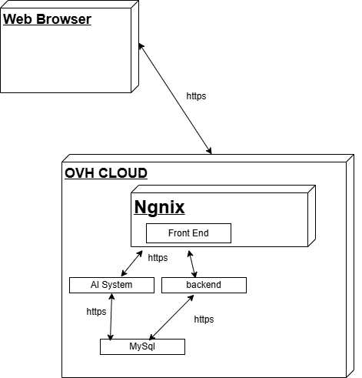
Deployment Diagram
38

Slide 39
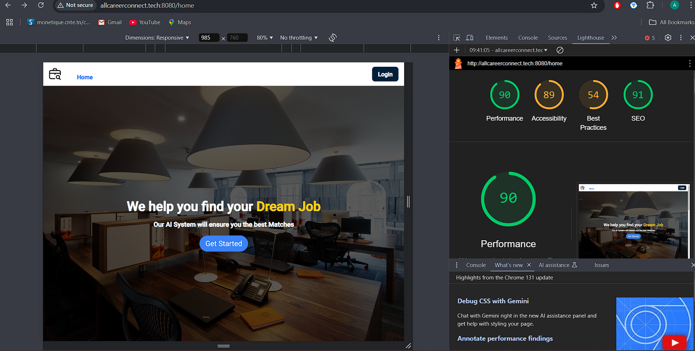
Site Audit
39

Slide 40

Jobify.
Application Demo

Slide 41
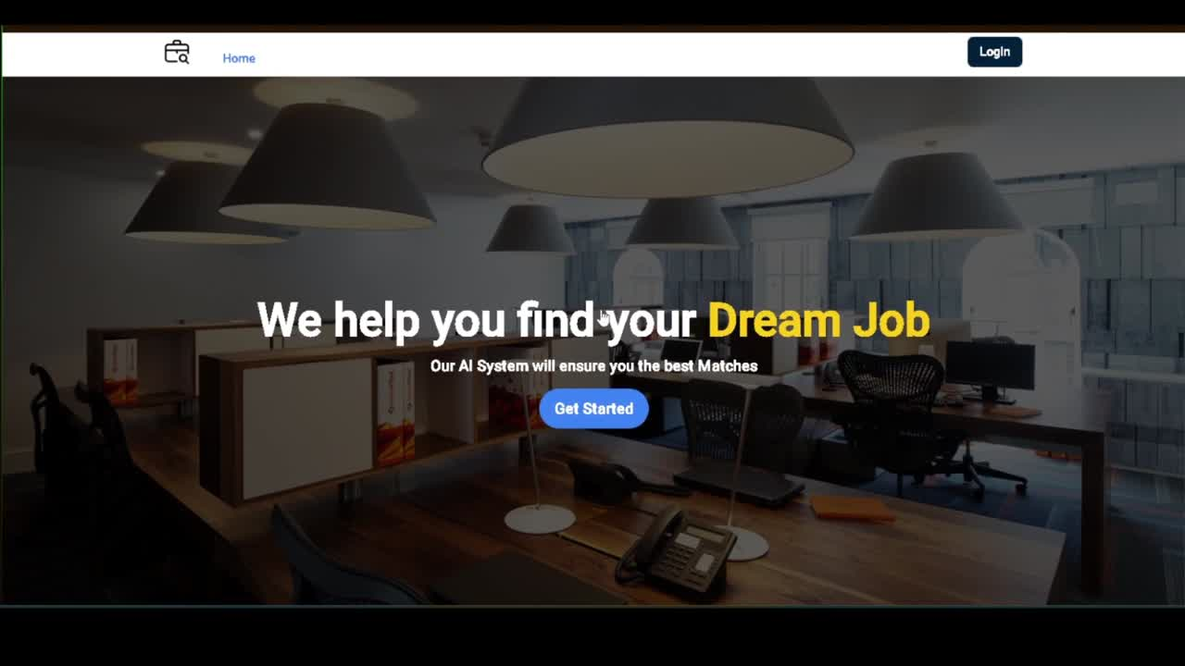
41

Slide 42
Jobify.
Conclusion
&
Prespective
Notes:
To conclude , we learned a lot throught out the project
its our first time using Scrum, we discovered the various things that the framework has to offer , why and when to use it and also how
we also learned how to handle teamwork , how to manage tasks, and how we should communicate
this project was a great experience that helped us improve ourselves individually and as a team,
Thank you for your attention , and we will gladly give answers to your questions

